Slide 1
Computer Science Class 2026-27
Classroom Presentation
. . .
/>
} /> [
</
Presented by your teachers

Slide 2
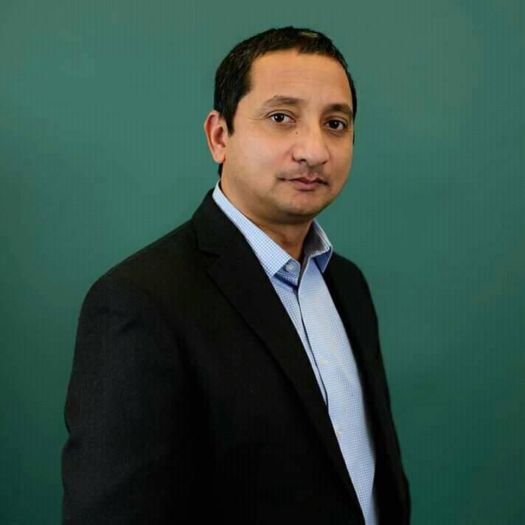
</ Principal of Everest IT
EverestIT Founder
Principal Technology Specialist (Microsoft)
Masters in:
Information Management
Healthcare Management
Senior Technical Leadership
~30 years in IT Field Experience
Bijay>

Slide 3
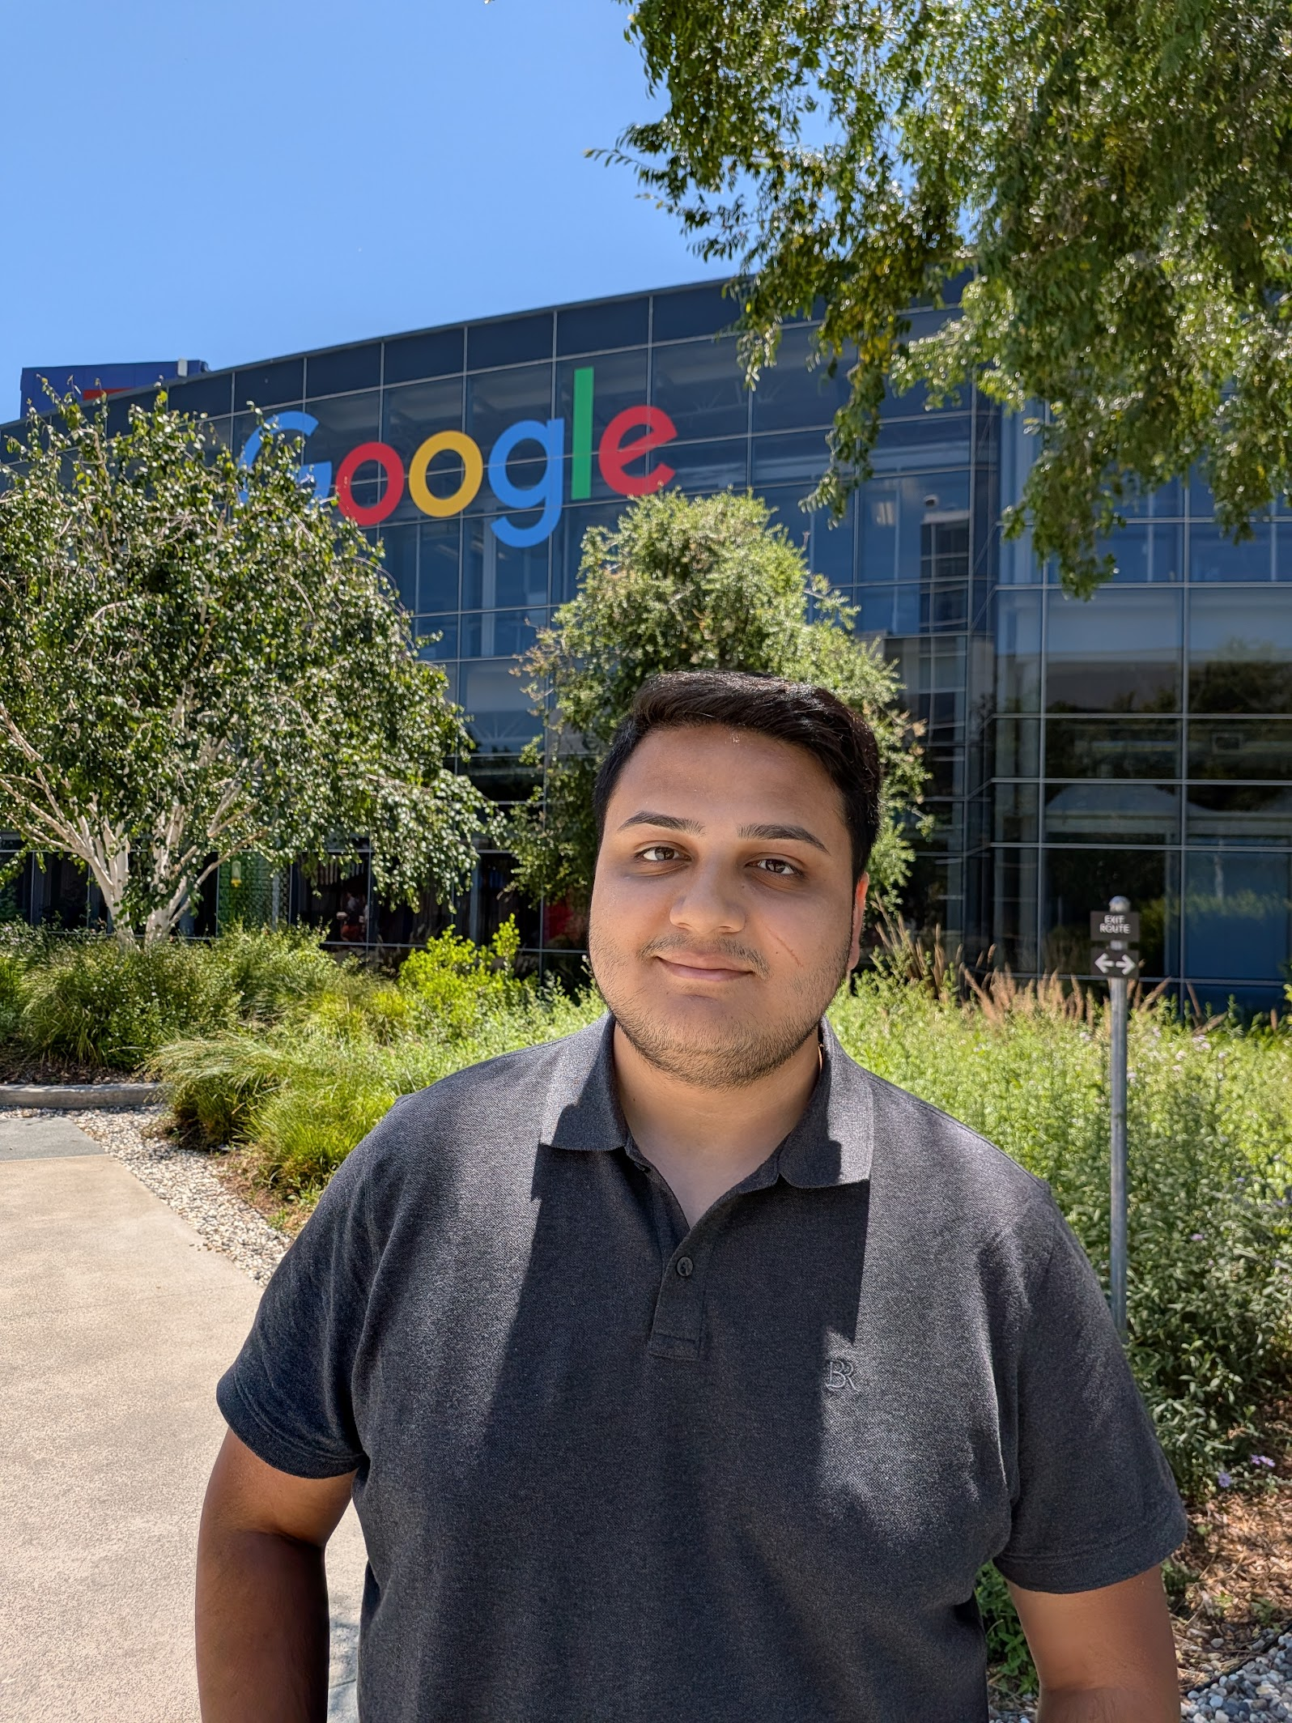
</ Teachers
Bachelors & Masters in Computer Science
Software Engineer Intern at Northrop Grumman and BNY
Software Engineer at Google​
Sanskar>

Slide 4
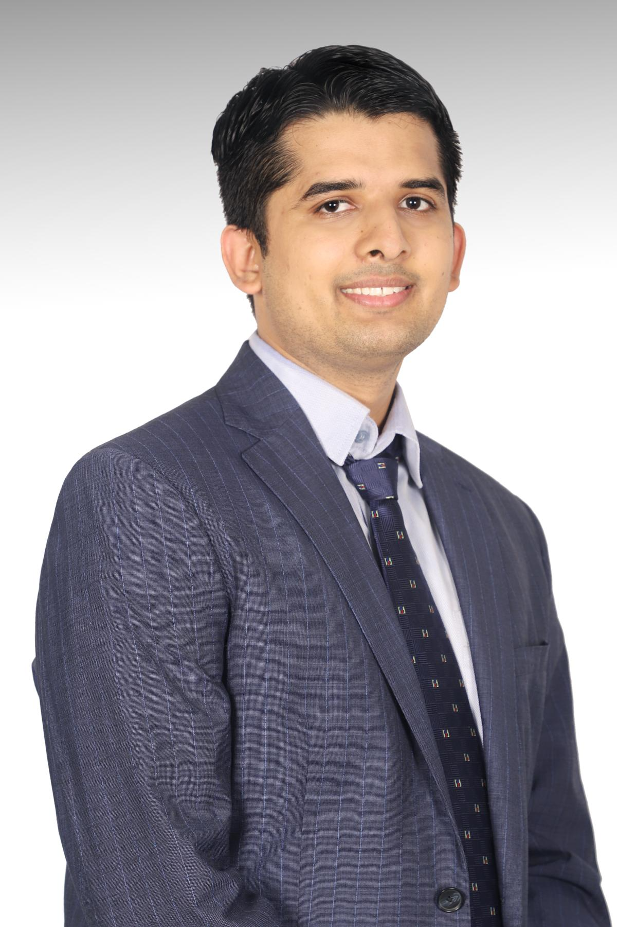
</ Teachers
Lead Software engineer at Flaship Financial Group
Avid learner
Masters in Software Engineering
FOSS contributor – Bitcoin, Large Language Models, OpenAI
Abhigya>

Slide 5
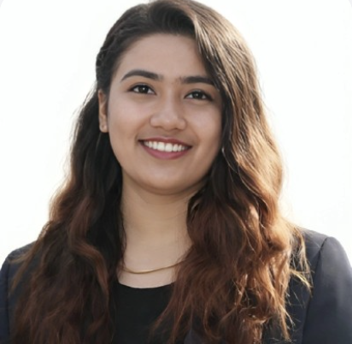
</ Assistant Teachers
/> **
Ishwari Ma'am

Slide 6
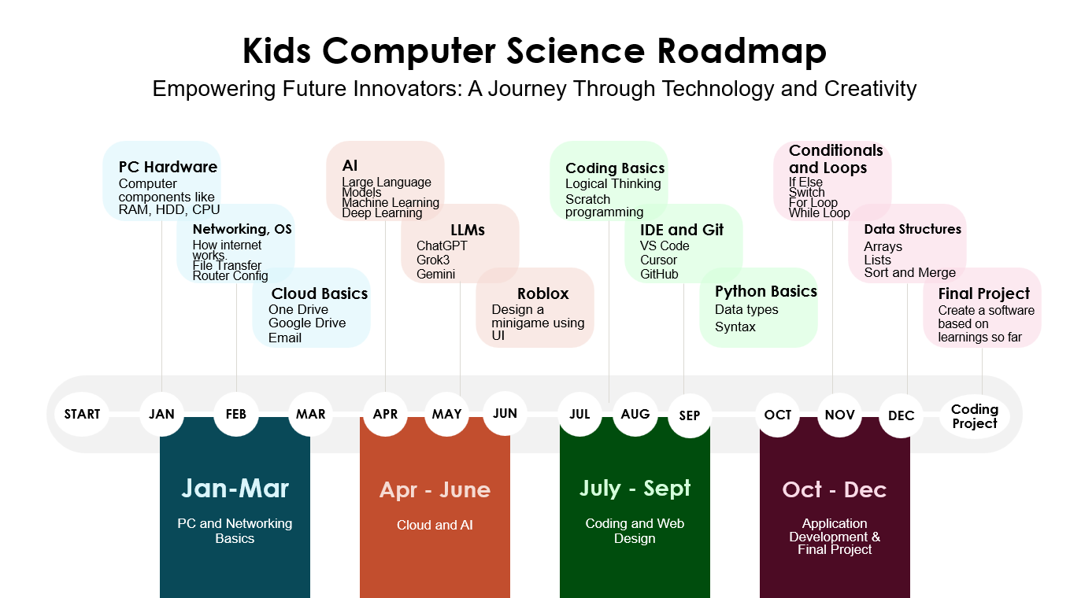
</ Rough Timeline of the Class (6 months to infinity)
(First Week)
Introduction
PC Hardware
Networking Basics
Windows
Cloud Basics (First Week)
Azure
AI
Final Project/Test

Slide 7
{Be respectful}
{Be on time}
{Be ready}
} /> [
Respect your fellow students and treat them as you want to be treated
Attend the class on time to be successful
Set yourself up for success by bringing the necessary tools
/>

Slide 8
Thank you!
Classroom Presentation
. . .
</
/>
} /> [
Kahoot time...

